Slide 1
Software Requirement Concepts & Process
Instructor: <Name>

Slide 2
Agenda
Requirement Concepts
Fsoft Requirement Process
Requirement Clarifying
Requirement Modeling
Modeling Tools
Common practices, problems

Slide 3
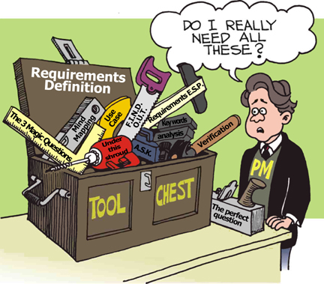
Requirement Concepts Requirement Definition
What is requirement?
A statement of a service the system must do OR
A statement of a constraint the system must satisfy
Notes:
A statement of a service the system must do
Example: the user shall be able to add a new contact to the address book
OR
A statement of a constraint the system must satisfy
Example: a search on contacts shall return a result in no more than 2 seconds
(1) A condition or capability needed by a stakeholder2 to solve a problem or achieve an
objective.
(2) A condition or capability that must be met or possessed by a system or system
component to satisfy a contract, standard, specification, or other formally imposed
documents.
(3) A documented representation of a condition or capability as in (1) or (2).

Slide 4
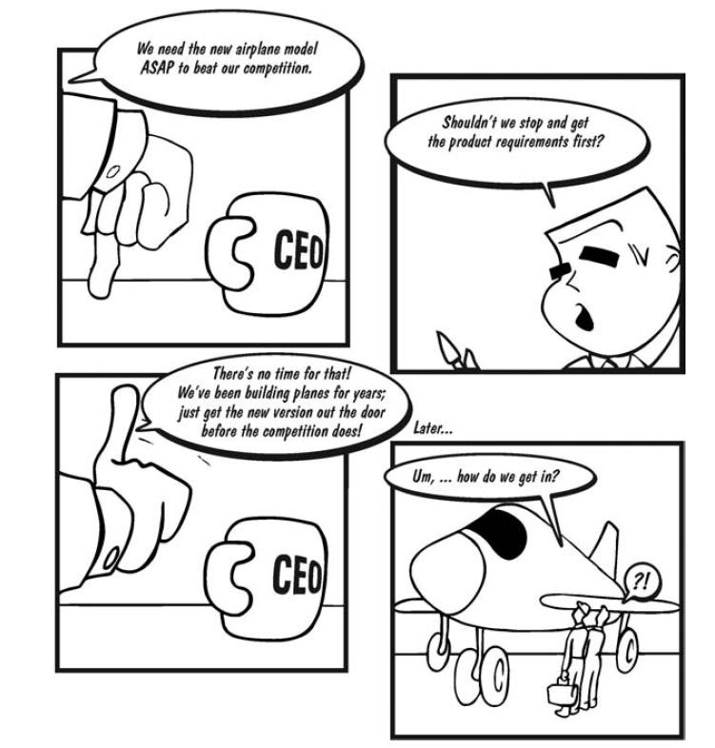
Requirement Concepts Requirement Definition
Why do we need requirements?
Notes:
Question: when do you need to define requirements?

Slide 5
Requirement Concepts Requirement Definition
Purpose of requirement:
Requirements often serve as:
The basis for a bid for a contract - therefore must be high-level to open for interpretation
The basis for the contract itself - therefore must be detailed
Thus, requirements can be high-level or detailed
What are not Requirements
Design or implementation details (other than known constraints)
Project planning information
Testing information

Slide 6
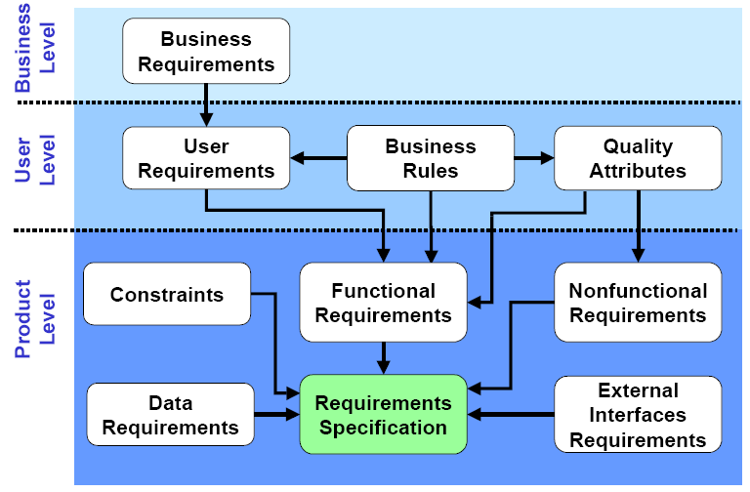
Requirement Concepts Requirements Classification 1/4
Notes:
Business level
Define business problems to be solved or business opportunities to be addressed by the software product
Define why the software product is being developed
Eg. HCVS offers customers an element of on-line fleet management, reporting and driver functionality, branded Capital Control. Linked to Capital Control are a number of bespoke customer driver web sites that have general driver information (for example car policy).
This offering has been developed and live for a number of years and was initially market leading. Over the past few years the competitors have developed better on-line capability that has leapfrogged the HCVS proposition.
This objective of the project is to provide a web-based eCommerce application and data warehouse to supersede Capital Control and Online Quoting tool and retake the market lead.
To achieve this business objective, the project will focus on the user experience.
User level (URD - could be use as part of a RFP (Request For Proposal) to open for contract bidding)
High-level descriptions of the system services and constraints
Focus on system’s functionality from user’s perspective
Define what system shall provide to achieve users’ objectives
Multiple user requirements to fulfill a single business requirements
Business rules are specific policies defining how users do business
Primarily for end-users and written in natural language (avoid technical terminologies) plus diagrams
Product level (Software requirement – SRS, ould be use as part of a contract between client and contractor)
Detailed descriptions of the system services and constraints
Specify functionality that must be built into the software to accomplish users’ tasks
Multiple product-level requirements to fulfill a single user-level requirements
Primarily for engineers to start design
Written in structured natural plus diagrams and math notations

Slide 7
Requirement Concepts Requirements Classification 2/4
Requirement may be classified as
Functional
A service the system has to perform
May include information the system must contain
Non-functional
A constraints the system must satisfy
Notes:
Non-functional may be
Law (system must follow law of labor, regulators, policies)
Industry standard
Security
Safety
Mobility
Maintainability
…

Slide 8
Requirement Concepts Requirements Classification 3/4
Sample of functional requirement
The “Data Entry Module” should provide the following functionality:
Data Entry for HR: allows HR staff to enter payroll data, either via web-based forms or by importing data from Excel files
Data Entry for Regional offices: allows the PGB’s regional offices to enter billing data, either via web-based forms or by importing data from Excel files

Slide 9
Requirement Concepts Requirements Classification 4/4
Sample of non-functional requirement
Product requirements
Requirements which specify that the delivered product must behave in a particular way
Categories: performance, reliability, usability, security, cultural, etc.
Organisational requirements
Requirements which are a consequence of organisational policies and procedures
Categories : technology, process, operation, time, budget, etc.
External requirements
Requirements which arise from factors which are external to the system and its development process
Categories : interoperability requirements, legislative requirements, etc.

Slide 10
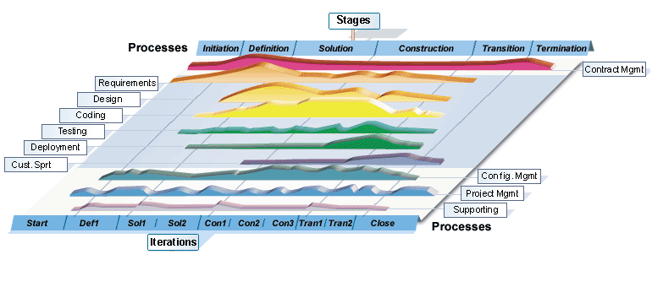
Fsoft Requirement Process
First phase of Software engineering
Notes:
Introduce overview about FSOFT software lifecycle (~RUP)
6 phase of project life cycle
Introduce process (disciplines) of software development
Develop iteratively
It is best to know all requirements in advance; however, often this is not the case. Several software development processes exist that deal with providing solution on how to minimize cost in terms of development phases.

Slide 11
Fsoft Requirement Process Objectives
To ensure that requirements for the software product are defined and understood.
Get to know what customer’s requirement is
Understand the customers’ needs & expectation
To create SRS - Establish and maintain requirements agreement with the requestor and affected groups
To ensure that the requirements are met.
Requirements are documented and controlled to establish a basis for software development and project management use.

Slide 12
Fsoft Requirement Process Workflow
Elicit & Analyze Requirements
Develop SRS
Validate Requirements
Analysis Records
SRS
Review Records
Requirement Management & Traceability
Manage Requirement Changes
Manage Requirement Status
Manage Traceability
RM Sheet
Change Records
Updated SRS

Slide 13
Fsoft Requirement Process Elicit & Analyze Requirements
Sometimes called requirements discovery
Requirements are often not given to you, you have to elicit them; Must work with customers and relevant stakeholders to elicit:
the services that the system should provide
the constraints that the system should satisfy
Requirement analysis is done to:
Detect and resolve conflicts between requirements
Discover the bounds of the software and how it must interact with its environment
Elaborate system requirements to derive software requirements

Slide 14
Fsoft Requirement Process Elicit & Analyze Requirements - Resource
Potential stakeholders
End-users
Managers
Owners
Customers of your customers
Operation engineers
Domain experts
Trade unions
Etc.

Slide 15
Fsoft Requirement Process Elicit & Analyze Requirements - Process
Identify stakeholders
Understand customer needs
State the problem
Discover requirements
Clarify requirements
Notes:
Identify the stakeholders. The term stakeholder includes anyone who has a right to impose requirements on the system. This includes end users, operators, maintainers, bill payers, owners, regulatory agencies, victims, and sponsors. All facets of the stakeholders must be kept in mind during system design.
Understanding of the customers’ needs.
If the sponsor, owner, and user are different, then the systems engineer must know and understand the needs of each.
The information necessary usually comes from the mission statement, the concept of operation, business model, preliminary studies, and specific customer requests. Usually the customer is not aware of what is needed. Systems engineers must enter the customer’s environment, discover the details, and explain them. Flexible designs and rapid prototyping facilitate identification of details that might have been overlooked.
Talking to the customer’s customer and the supplier’s supplier can also be useful. This activity is frequently referred to as mission analysis. It is the systems engineer’s responsibility to ensure that all information concerning the customer’s needs is collected.
The systems engineer must also ensure that the definitions and terms used have the same meaning for everyone involved. Several direct interviews with the customer are necessary to ensure that all of the customer’s needs are stated and that they are clear and understandable. The customer might not understand the needs; he/she may be responding to someone else’s requirements. Often, a customer will misstate his/her needs;
State the problem
Early in the process, the customer frequently fails to recognize the scope or magnitude of the problem that is to be solved. The problem should not be described in terms of a perceived solution. It is imperative that the systems engineer help the customer develop a problem statement that is completely independent of solutions and specific technologies. Solutions and technologies are, of course, important; however, there is a proper place for them later in the systems engineering process. It is the systems engineer’s responsibility to work with the customer, asking the questions necessary to develop a complete picture of the problem and its scope.
For example, the U.S. Air Force did not know that they wanted a stealth airplane until after the engineers showed that they could do it. During concept exploration, encourage consideration of bizarre alternatives. This will help you understand the requirements better. Likewise, studying models and computer simulations will help you understand the requirements.
Understanding the requirements is one of the most fruitful phases in requirements discovery.
Defining what the system is supposed to do could be done in terms of a hierarchy of functions. But recently it is being stated in terms of a hierarchy of capabilities the system must have.
Discover requirements
The systems engineer must consult with the customer to discover the system requirements. The systems engineer must involve the customer in the process of defining, clarifying, and prioritizing the requirements. It is prudent to involve users, bill payers, regulators, manufacturers, maintainers, and other key stakeholders in the process. Requirements are discovered or elicited: they are not given to you. It takes work to find out what the requirements are.
Next, systems engineering must discover the functions that the system must perform in order to satisfy its purpose. The system functions form the basis for dividing the system into subsystems.
Although this makes it sound as if requirements are transformed into functions with a waterfall process, that is not the case. The requirements process is highly iterative and many tasks can and should be done in parallel. First, we look at system requirements, then at system functions. Then we reexamine the requirements and then reexamine the functions. Then we reassess the requirements and again the functions, and so on. Identifying the system’s functions helps us to discover the system’s behavioral requirements.
For each requirement that is discovered, ask yourself why the requirement is needed. This will help you to write the rationale for the requirement, it will help you to prioritize the requirements, and it might help you to negotiate with the customer to eliminate some requirements.
Clarify requirements
The systems engineer must consult with the customer to ensure that the requirements are correct and complete and to identify the trade-off requirements. As with all systems engineering processes, this process is iterative. The customer should be satisfied that if the requirements are met, then the system will do what it needs to do. This should be done in formal reviews with the results documented and distributed to appropriate parties. These reviews ensure that all the requirements have been met, ensure that the system satisfies customer needs, assess the maturity of the development effort, allow recommending start of the next phase, and facilitate approval to committing additional resources. The systems engineer is responsible for initiating and conducting these reviews. The system requirements must be reviewed with the customer many times. At a minimum, requirements should be reviewed at the end of the modeling phase, after testing the prototypes, before commencement of production, and after testing production units.
It is the job of the systems engineer to push back on the customer. The systems engineer should try to get requirements removed or relaxed. Perform a sensitivity analysis on the requirements set to determine the cost drivers. Then show the customer how cost can be reduced and performance enhanced if certain requirements are changed. The requirements process should be a continual interactive dialogue with the stakeholders.
The main objectives of these reviews are to find missing requirements, eliminate unneeded requirements, ensure that the requirements have been met, and verify that the system satisfies customer needs. At these reviews, trade-offs will usually have to be made among performance, schedule, and cost. Additional objectives include recommending whether to proceed to the next phase of the project and committing additional resources. The results and conclusions of the reviews should be documented. Again, the systems engineer is responsible for initiating and conducting these reviews.

Slide 16
Fsoft Requirement Process Elicit & Analyze Requirements - Issues
Issues of scope
The boundary of the system is ill-defined
The customers/users specify unnecessary technical detail that may confuse overall system objectives
Issues of understanding
The customers/users are not completely sure of what is needed
Have a poor understanding of the capabilities and limitations of their computing environment
Don’t have a full understanding of the problem domain, have trouble communicating needs to the system engineer

Slide 17
Fsoft Requirement Process Elicit & Analyze Requirements - Issues
Issues of understanding (cont’d)
Omit information that is believed to be “obvious”
Specify requirements that conflict with the needs of other customers/users
Specify requirements that are ambiguous or un-testable.
Issues of volatility
The requirements change over time

Slide 18
Fsoft Requirement Process Elicit & Analyze Requirements - Techniques
Elicitation Techniques
Researching application domain
Interviewing and questionnaires
Workshop and brainstorming
Storyboarding and role playing
Observation
Use cases
Analyzing Techniques
System modeling
Rapid Prototyping
Notes:
Refer hand out
Interview:
Simple direct technique
Context-free questions can help achieve bias-free interviews – See course web site for examples
Then, it may be appropriate to search for undiscovered requirements by exploring solutions.
Convergence on some common needs will initiate a “requirements repository” for use during the project.
A questionnaire is no substitute for an interview.
Ex: These are on the course web site. Each section on slide has several questions under it in the document.
Establish Customer or User Profile
Name:
Company:
Industry:
Job Title:
What are your key responsibilities?
What outputs do you produce?
For Whom?
How is success measured?
Which problems interfere with your success?
What, if any, trends make your job easier or more difficult?
Assessing the Problem
For which problems do you lack good solutions?
What are they? (Hint: Keep asking, “Anything else?”)
For each problem ask:
Why does the problem exist?
How do you solve it know?
How would you like to solve it?
Understanding the User Environment
Who are the users?
What is their educational background?
What is their computer background?
Are users experienced with this type of application?
Which platforms are in use?
What are your plans for future platforms?
What are your expectations for usability for this type of product?
What are your expectations for training time?
What kinds of user help do you need?
Recap the Understanding
You have told me:
(List customer described problems in your own words.)
Analyst’s Inputs on Customer’s Problems
(Validate or Invalidate assumptions)
For each problem ask,
Is this a real problem?
What are the reasons for the problem?
How do you currently solve the problem?
How would you like to solve the problem?
How would you rank solving these problems in comparison to others you’ve mentioned?
Assessing Your Solution (if applicable)
What if you could
How would you rank the importance of these?

Slide 19
Fsoft Requirement Process Develop SRS - Requirement documents 1/3
Requirements document is the official document of what is required for the system
Often include only system requirements but sometimes may also include user requirements
It is NOT a design document. Describe WHAT the system should do rather than HOW it should do

Slide 20
Fsoft Requirement Process Develop SRS - Requirement documents 2/3
URD – User requirement definition
Address what users need to do their jobs
Composed all business requirements formulated by customer, business rules and other constrains
SRS – Software requirement specification
A set of software requirements as complete, consistent, and correct as possible, from the developer's point of view
Document which after baselining, common reference point of the software requirements for customer, developer, tester and PM .
Notes:
Trainer show sample of FSOFT document as URD and SRS
URD – User requirement
SRS – System requirement

Slide 21
Fsoft Requirement Process Develop SRS - Requirement documents 3/3
Benefit of good document
Basis for agreement between the customers and the team on what the software product is to do.
Reduce the development effort.
Provide a basis for estimating costs, schedules.
Provide a baseline for validation and verification.
Facilitate transfer.
Serve as a basis for enhancement

Slide 22
Fsoft Requirement Process Develop SRS – Steps & Activities
Study URD:
Analyze user requirement
Prepare Q&A list to clarify unclear items with customers
Call/interview customers if needed
SRS:
Develop use cases, system requirement
Develop functional specification
Review and approve SRS:
Call up meeting for review
Keep meeting minutes records
Notes:
10/2/2015
22

Slide 23
Fsoft Requirement Process Develop SRS – Techniques
Specify requirements using structured natural language (forms, tables, etc.)
Functional requirements can be specified using modeling - a combination of graphical notations and structured natural language
Use cases
Use case diagrams
Use case specifications
Non-functional requirements can’t be modeled => specified using structured natural language only

Slide 24
Fsoft Requirement Process Develop SRS - Characteristics of good SRS
Correct: requirement ~ what the software shall meet.
Unambiguous:
Has only one interpretation (to both creator & user)
Use natural language & avoid the words like: maybe, generally, etc.
Complete
Include all significant requirements.
Define all the software responses & include all the refs/labels.
Use of TBD: should avoid OR mention why, what to do, who, when.
Consistent: no conflict between individual requirements.
Verifiable: reviewable & testable in finite cost-effective process.
Traceable: clear origin & good reference for future dev/enhance documents.
Notes:
Correct - This is like motherhood and apple pie. Of course you want the specification to be correct. No one writes a specification that they know is incorrect. We like to say - "Correct and Ever Correcting." The discipline is keeping the specification up to date when you find things that are not correct.
Unambiguous - An SRS is unambiguous if, and only if, every requirement stated therein has only one interpretation. Again, easier said than done. Spending time on this area prior to releasing the SRS can be a waste of time. But as you find ambiguities - fix them.
Complete - A simple judge of this is that is should be all that is needed by the software designers to create the software.
Consistent - The SRS should be consistent within itself and consistent to its reference documents. If you call an input "Start and Stop" in one place, don't call it "Start/Stop" in another.
Verifiable - Don't put in requirements like - "It should provide the user a fast response." Another of my favorites is - "The system should never crash." Instead, provide a quantitative requirement like: "Every key stroke should provide a user response within 100 milliseconds."
Traceable - Often, this is not important in a non-politicized environment. However, in most organizations, it is sometimes useful to connect the requirements in the SRS to a higher level document. Why do we need this requirement?

Slide 25
Fsoft Requirement Process Develop SRS - SRS Review Checklist
SRS Review Checklist
To review the requirements by yourself
Make sure you understood completely the requirements:
Organization and Completeness: adequate, no missing, etc.
Correctness: no conflict, verifiable, in scope, message, etc.
Non-functional requirements, quality attributes, etc.
Template (See Checklist - Review Requirement.xlsx)
Notes:
Trainer show sample of FSOFT document as URD and SRS
URD – User requirement
SRS – System requirement

Slide 26
Fsoft Requirement Process Validate Requirements – Purpose
Make sure that the requirements define the system that the customer really wants
Requirements error costs are high so validation is very important
Fixing a requirements error after delivery may cost up to 100 times the cost of fixing an implementation error

Slide 27
Fsoft Requirement Process Validate Requirements – Process
Validity check
Consistency check
Completeness check
Realism check
Verifiability check
Notes:
Validity check
A user may think that a system is needed to perform certain functions. However, further thought and analysis may identify additional or different functions that are required. Systems have diverse stakeholders with distinct needs and any set of requirements is inevitably a compromise across the stakeholder community.
Does the system provide RIGHT functionalities as customer’s NEED?
Consistency check
Requirements in the document should not conflict. That is, there should be no contradictory constraints or descriptions of the same system function.
Is there any requirement CONFLICT?
Completeness check
The requirements document should include requirements which define all functions, and constraints intended by the system user.
Are all functions required by customer INCLUDED?
Is there any common checklists that you can use?
Realism check
Using knowledge of existing technology, the requirement should be checked to ensure that they could actually be implemented. These checks should also take account of the budget and schedule for the system development.
Can requirement be IMPLEMENTED with given available budget and technology?
Verifiability check (in FSOFT process ~ acceptance criteria – a part in SRS)
To reduce the potential for dispute between customer and contractor, system requirements should always be written so that t hey are verifiable. This means that you should be able to write a set of tests that can demonstrate that the delivered system meets each specified requirement.
Can requirement be TESTED?

Slide 28
Fsoft Requirement Process Validate Requirements – Techniques
Requirements Review
Systematic manual analysis of the requirements
Involving development staff, customers and relevant stakeholders
Prototyping
Using an executable model of the system to check requirements
Model Validation
Validate the quality of the models developed during analysis
Test-case generation
Developing tests for requirements to check testability

Slide 29
Fsoft Requirement Process Requirements management
Manage requirement in FSOFT
Requirement Management Sheet, Excel sheet, used to track the status, relationship and change of requirements during the whole project.
A mandatory document (dynamic version of SRS)
Classify requirement to functional/non-functional requirement
To maintain the common reference for all related parties (traceability of requirement and software product)
To track the project progress (status of requirement)
To track the change (including change request)
To collect requirement related metrics for reporting
The sheet is created the first time client requirement come
Notes:
Trainer show sample of RMS here and introduce overview about this document.

Slide 30
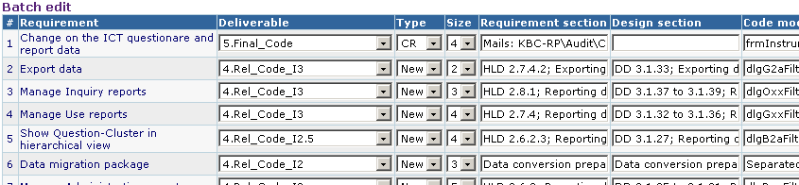
Fsoft Requirement Process Requirement Traceability
Why is traceability necessary?
The requirements can change at any stage during the product’s life.
If the requirements are traceable, then when changes happen, it is far easier to find the impacted parts of the product
User Needs
Software
Requirements
Work
Products
Software
Requirements
Use cases/
User Requirements
Test cases
Notes:
Trainer show sample of RMS here and introduce overview about this document.

Slide 31
Fsoft Requirement Process Requirement Changes Management
Requirements change (CR – Change request)
The priority of requirements from different viewpoints changes during the development process
Customers may specify requirements from a business perspective that conflict with end-user requirements
The business and technical environment of the system changes during its development
Requirements change process

Slide 32
Requirement Clarifying
PM/TL/BA present the SRS to members in the team
Self study related materials: top-down approach
Using FSOFT’s SRS review checklist
Clarify unclear item(s) using Q&A
Discuss with other members
To clarify or confirm your understanding
Media: direct discussion or via team brainstorming
Inform the PM/TL/BA about
Any requirement conflicts
Changes, comparing to the last version

Slide 33
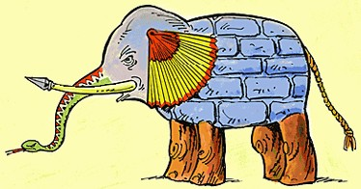

Requirement Clarifying Clarifying requirement via Q&A
Why do we need Q&A?
Problems of understanding
Want for knowledge, must be ask

Slide 34
Requirement Clarifying Clarifying requirement via Q&A (cont.)
How to make Q&A effectively?
Identify the issue: unclear, get for more information, etc.
Check in all documents that customer supplied to make sure your question has not solved;
With technical question, check your team /group/company or ask “Google” to solve it before asking out
Give the cross-reference clearly, completely
Attach sample screen, demo, give your suggestions if any
Convert questions to Y/N or multiple-choice types if possible
In Q&A, give deadline that you want to receive the answer. It there is no answer until the deadline, what is impact?
Take the receiver to re-read the question before sending

Slide 35
Requirement Clarifying Clarifying requirement via Q&A (cont.)
Q&A focus:
Question for idea conveyed by words like: maybe, generally, etc.
What is the TBDs - Ask PL to remove all TBDs before handling to you for designing or coding
Conflict between requirements. Read the requirement matrix
Don’t make assumptions, just ask your PM, PL or BA
Follow up the Q&A
Track the discussion history for easier following up
If your question has not been replied or impacts to your task must be report to your PM, BA, or TL immediately
Keep in mind your manager/customer are very busy. So it is necessary to remind them about your pending issues daily, weekly. If not, your task will be impacted
Template on Q&A Management Sheet: 02_SWR_Software Requirement\Student\Assignments\Templates\StudentName - Topic - Q&AList.xls

Slide 36

Requirement Modeling Modeling objectives
Why model requirement?
To understand clearly the functionalities of system
To present the system from different perspectives
Notes:
Key point
System modelling helps the analyst to understand the functionality of the system and models are used to communicate with customers.
Different models present the system from different perspectives
External perspective showing the system’s context or environment;
Behavioural perspective showing the behaviour of the system;
Structural perspective showing the system or data architecture.

Slide 37
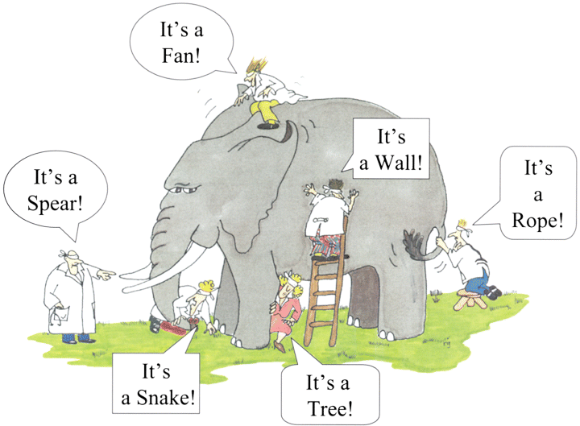
Requirement Modeling Model different perspectives
Model different perspectives
Models help present different aspects of the system, using different abstraction
Notes:
That is why we need common way to model requirement

Slide 38
Requirement Modeling System Modeling Tools
The system modeling presents an abstraction of the system in software aspects, which helps understanding of the functional requirements in block diagram form, and helps to identify all required software elements & tasks.
Common modeling tools:
Use case
Data flow diagram
Behavioural
model
Object model
Sequence diagram
Aggregation
Activity diagram
State machine diagram
Inheritance
Notes:
By the way of developing of OOA, we only introduce detail about Use case
The Dynamic (Behavioral) Model
The Static (Structural) Model

Slide 39
Modeling Tools - Use Case
Requirements capture
Requirements are reason-for-existence of any software development project
Defines and delineates user-requirements
Defines the functionality to be provided
Identifies the goals to be achieved
Must be precisely and completely understood
Requirements often changes, thus must be well-documented
Notes:
A use case is a use to which the system will be put as someone or something interacts with it. The description of the use case should describe the series of steps that take place during the interaction and include different ways that this interaction could play out.\

Slide 40
Modeling Tools - Use Case
Requirement capture with UML
Use Case diagram
Shows a set of use cases, actors and their relationships
Captures problem-domain in terms of:
functionality to be provided (Use Cases)
the “roles” (Actors) for whom these functions are performed

Slide 41
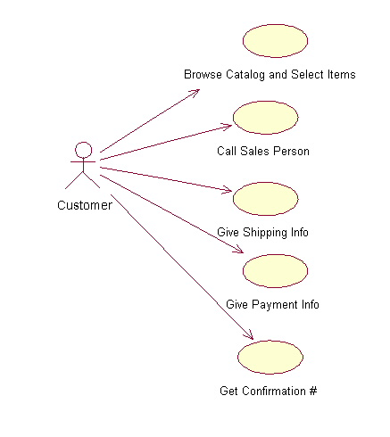
Modeling Tools - Use Case Use Case Diagram
Actor
overview the usage requirements
presentations project stakeholders
"the meat" of the actual requirements
Use case:
A use case describes a sequence of actions that provide something of measurable value to an actor and is drawn as a horizontal ellipse
System boundary:
indicates the scope of your system. Anything within the box represents functionality that is in scope and anything outside the box is not
Actor:
An actor is a person, organization, or external system that plays a role in one or more interactions with your system
Use case
Online C2C shopping
System boundary
Notes:
Use case definition
An abstraction of a set of sequences of actions that yields some functionality
Represents some user-visible function.
Always initiated by an “actor”
Describes the interaction between the actors and the system for a system function
Achieves a discrete goal for the actor
Finding use cases
What functions does the system perform?
What functions do the “actors” require?
What input/output does the system need?
What verbs are used to describe the system?
The Reservation Clerk makes a booking using the system, based on the...
The Airport Manager can make an entry for a new flight. He can also modify flight details ...
Actor
A role that interacts with the system
Represents a role, not individuals
can be a person, a device, or another system
Communicate with the system by sending, receiving messages
May participate in many use cases; a use case may have several actors participating in it
Finding actors
Who uses the main functionality of the system?
Which hardware devices the system needs to handle?
Which other external systems does the system need to interact with?
Identify nouns/subjects used to describe the system
The Reservation Clerk makes a booking using the system, based on the...
A user must login in order to save his itinerary

Slide 42

Modeling Tools - Use Case Use Case Diagram - Notations
Use case diagram: Notations
use case
A description of a set of sequences of actions that system performs that provides an observable value to an actor
Do it
actor
The people or systems that provide or receive information from the system; they are among the stakeholders of a system
include
Specifies that the source use case explicitly incorporates the behavior of another use case at a location specified by the source
<<include>>
extend
Specifies that the target use case extends the behavior of the source.
<<extend>>

Slide 43
Modeling Tools - Use Case Example - Use Case 1/2
A company wants to develop a ticketing and reservation system. This must support advance booking of tickets, cancellation of tickets and change of class of a ticket. All these are handled by a Reservation Clerk.
The system will also have a Web site where users can register themselves and purchase tickets online. They can pay either by using their online banking account or by credit card. Reservations made over the internet can only be cancelled across the counter.
The system will also have a querying facility that allows users to check train time-tables, fares and availability of tickets.
Use case example
A company wants to develop a ticketing and reservation system. This must support advance booking of tickets, cancellation of tickets and change of class of a ticket. All these are handled by a Reservation Clerk.
The system will also have a Web site where users can register themselves and purchase tickets online. They can pay either by using their online banking account or by credit card. Reservations made over the internet can only be cancelled across the counter.
The system will also have a querying facility that allows users to check train time-tables, fares and availability of tickets.
Notes:
Use case definition
An abstraction of a set of sequences of actions that yields some functionality
Represents some user-visible function.
Always initiated by an “actor”
Describes the interaction between the actors and the system for a system function
Achieves a discrete goal for the actor
Finding use cases
What functions does the system perform?
What functions do the “actors” require?
What input/output does the system need?
What verbs are used to describe the system?
The Reservation Clerk makes a booking using the system, based on the...
The Airport Manager can make an entry for a new flight. He can also modify flight details ...
Actor
A role that interacts with the system
Represents a role, not individuals
can be a person, a device, or another system
Communicate with the system by sending, receiving messages
May participate in many use cases; a use case may have several actors participating in it
Finding actors
Who uses the main functionality of the system?
Which hardware devices the system needs to handle?
Which other external systems does the system need to interact with?
Identify nouns/subjects used to describe the system
The Reservation Clerk makes a booking using the system, based on the...
A user must login in order to save his itinerary

Slide 44
Modeling Tools - Use Case Example - Use Case 2/2
Make Reservation
Cancel Reservation
Modify Class
Check train time-table
Query Timetable
Check Fare
Register as Member

Slide 45
Modeling Tools - Use Case Example - Use Case Diagram
Modify Class
Use case diagram
Check Fare
Query Timetable
Reservation Clerk
Passenger
Make Reservation
Cancel Reservation
Register as Member
Check train time-table

Slide 46
Modeling Tools - Use Case Use Case Specification 1/7
Text description of use case functionality in the user language and terminology
No specific UML format
Describes WHAT and not HOW
Typically includes:
Objectives of the use case
How the use case is initiated
The flow of events (main flow, alternative flow)
How the use case finishes with a value to the actor
and more...
Notes:
A use case is described by a text description. It concentrates on the external behavior of the system and ignores how things are done inside the system. The text should be clear and consistent so that a customer can understand and validate it.
A use case describes the functionality as a whole, including possible alternatives, errors, and exceptions that can occur during the execution of the use case.
A high-level use case describes a process very briefly. High level use cases are defined during initial requirements definition and project scoping.
An expanded use case describes a process in more detail than a high-level one. It describes the step-by-step events.
During the requirements phase, important use cases can be written in expanded format, and detailed description of less important ones can be deferred to the development cycle in which they will be tackled.

Slide 47
Modeling Tools - Use Case Use Case Specification 2/7
Use case description serves as a ‘bridge’ between stakeholders of a system and the development team.
Systems analyst produce use
case diagram & use case
specification in consultation
with end users
Use Case
Diagram
Use Case
Specification
Notes:
Use case description serves as a ‘bridge’ between stakeholders of a system and the development team.
An instantiation of a use case is called a scenario, and it represents the actual usage of the system (a specific execution path through the system).
A use case can also be described through an activity diagram.

Slide 48
Modeling Tools - Use Case Use Case Specification 3/7
Flow of events
Use Case is an abstraction of behavior (set of sequences)
The behavior of the Use Case can be described by a “flow of events” - which spells out in detail what exactly the Use Case does
main flow: what happens and in what order when all is well
alternate flow(s): what happens and in what order when something goes wrong
exception flow: things don’t always go as planned. An exception is an error condition that is important enough to the application to capture
Notes:
A flow of events or pathway is a textual description embodying sequence of events with regards to the use case and is part of the use case specification.
Flow of events is understood by the customer. A detailed description is necessary so that one can better understand the complexity that might be involved in realising the use cases.
Flow of events describes how and when the use case starts and ends, when the use case interacts with the actors, and the information exchanged between an actor and the use case.
Flow of events is derived from a what perspective, NOT how perspective. Hence, specific information like: interface details and technical specifications should NOT be included in a use case description.
Basic Flow of Events (Happy Path): is the most common pathway. It usually depicts a perfect situation, in which nothing goes wrong. – You get to the ATM and successfully withdraw money
Alternate Flow of Events - is a pathway that is still considered a good pathway; it’s just not the most heavily travelled one (You get to the ATM but could not withdraw money due to insufficient funds in your account.)
Exception Flow of Events (Unhappy Pathway) – You get to the ATM machine but your valid pin number is not accepted.

Slide 49
Modeling Tools - Use Case Use Case Specification 4/7
Key components | Explanation
Name | Clear, unique name of the use case (verb, goal-driven)
Actors | Someone or something that interacts with the use case
Description | Brief overview of the use case, describing the main idea
Goal | What the actors achieve with this use case
Pre-condition | State(s) the system can be in before the use case starts
Trigger | Event that causes the use case to be initiated
Post-condition | State(s) the system can be in after the use case finishes

Slide 50
Modeling Tools - Use Case Use Case Specification 5/7
Key components | Explanation
Normal flow | Typical (primary) processing path
Alternative flow | Alternative (secondary) processing path
Exception flow | When things go wrong at the system level
Others | Business rules, Assumption, Notes, etc.

Slide 51
Modeling Tools - Use Case Use Case Specification 6/7
Example
Make a seat reservation use case
Name | Make reservation
Actors | Passenger
Description | Allows a passenger to book a plane seat for a journey from the Website
Goal | Reserve a seat
Pre-condition | Main Webpage is displayed successfully
Trigger | User clicks on “Reserve seat” button on the main Webpage
Post-condition | A seat is booked Number of available seats is reduced

Slide 52
Modeling Tools - Use Case Use Case Specification 7/7
Example
Make a seat reservation use case
Normal flow | [User log in and reserve a seat successfully] 1. User logs in 2. User specifies a flight and travel details 3. User specifies passenger details 4. User specifies payment details 5. User confirms transaction
Alternative flow | [When no seat is available on the selected date] Show option to select another day Repeat steps in normal flow
Exception flow | [When a payment is failed] Notify error with the payment Give an option to re-enter payment details or other payment method
Notes:
Qualities of a Good Use Case
The following guidelines have proven useful in producing tight, easy-to-understand use cases in a variety of contexts:
Use active voice, and speak from the actor's perspective. For some reason, engineers and other technically inclined people tend to rely heavily on passive voice: "The connection is made," "The item is selected by the customer," and so forth. You should always express use cases in active voice. After all, you wouldn't expect to see a user manual written in passive voice, and there's a direct correlation between use cases and user manual text. (The most significant difference is that the latter is written in what's called the second-person imperative, with an unspoken "you," whereas use case text is written in the third person, in terms of specific actors and the system.)
Use present tense. Requirements are usually written in the future tense: "The system shall do this and that," "The throughput of the system shall meet the following parameters." Each sentence of a use case should appear in the present tense: "The Customer selects the item," "The system makes the connection." This includes the text for alternate courses. (For example, "If the Customer selects a different item, the system comes to a grinding halt.") Keeping all the text in a consistent form makes it easier for its readers to trace the different paths through the basic course and alternate courses.
Express your text in the form of "call and response." The basic form of your use case text should be "The [actor] does this" and "The system does that." The actor may do more than one thing consecutively, and the same holds true for the system, but the text should reflect the fact that the actor performs some action and the system responds accordingly. There shouldn't be any extraneous text.
Write your text in no more than three paragraphs. One of the guiding principles of object-oriented design is that a class should do a small number of things well, and nothing else. Why not adhere to this principle with use cases as well? A use case should address one functional requirement, or perhaps a very small set of requirements, and do it in a way that's obvious to anyone who reads it. Anything more than a few paragraphs, and you probably have a candidate for another use case. (See the section "Organizing Use Cases," later in the chapter, for a discussion of how to break up and organize use cases.) A sentence or two, however, is a signal that you don't have enough substance in your use case. Each use case should be a small, mobile unit that lends itself to possible reuse in other contexts.
Name your classes. There are two basic kinds of classes that lend themselves to inclusion in use case text: (a) those in the domain model (see the section "Domain-Level Class Diagrams" in Chapter 3) and (b) "boundary" classes, which include those windows, HTML pages, and so on that the actors use in interacting with the system. Down the line, it's going to be easier to design against text such as "The Customer changes one or more quantities on the Edit Contents of Shopping Cart page" and "The system creates an Account for the Customer" than against less-specific text (for example, "The Customer enters some values on an HTML page"). Be careful, though, to avoid including design details. You wouldn't talk about, say, the appearance of that HTML page or exactly what happens when the system creates an Account. The idea is to provide just enough detail for the designers to understand what's needed to address the basic requirements spelled out by the use cases.
Establish the initial context. You have to specify where the actor is, and what he or she is looking at, at the beginning of the use case. There are two ways to do this. The first way involves specifying the context as part of the first sentence: "The Accountant enters his or her user ID and password on the System Login window," for example. The second way involves defining a precondition: "The Accountant has brought up the System Login window." Doing this also makes it easier for someone to piece together the larger picture across a set of use cases.
Make sure that each use case produces at least one result of value to one or more actors, even if that result is negative. It's important to remember that a use case can't just end floating in space—something measurable has to happen. Of course, this is generally some positive result: "The actor is logged in to the system," "The system completes the actor's task by updating the database," "The system generates a report." A use case can end on an alternate course of action, though, so "The system locks the user out of the system and sends an email to the system administrator" is also a viable result, even though it's hardly a desirable one.
Be exhaustive in finding alternate courses of action. A lot of the interesting behavior associated with a system can be nicely captured within alternate courses—and it's a well-established principle that it's a lot cheaper to address this kind of behavior early in a project rather than later. A highly effective, if sometimes exhausting, way to root out alternate courses is to "challenge" every sentence of the basic course. In other words, ask repeatedly, "What can the actor do differently—or wrong—at this point?" or "What can go wrong internally at this point?" Remember two things while you're doing this. First, you don't need to account for generic failure conditions—network down, database inaccessible—within each use case; focus on those things that might happen in the specific context of the use case. Second, remember to take into account not only the novice/unsophisticated user but also the malicious user, the person who tries things he or she shouldn't just to see what might happen.
There are a couple of good methods for pointing to alternate courses from within the basic course. One surefire way to signal the presence of an alternate course involves using words such as validates, verifies, and ensures within the basic course. Each time one of these words appears, there's at least one associated alternate course, by definition, to account for the system's inability to validate, verify, or ensure the specified condition. For example, the basic course might say, "The system verifies that the credit card number that the Customer entered matches one of the numbers it has recorded for that Customer," while the corresponding alternate course might read, "If the system cannot match the entered credit card number to any of its stored values, it displays an error message and prompts the Customer to enter a different number." Another way to indicate the presence of an alternate course involves using labels for the alternate courses and then embedding those labels in the basic course. For example, an alternate course might have a label A1, and that label would appear in parentheses after the relevant statement(s) in the basic course.

Slide 53

Modeling Tools - DFD
DFD = Data Flow Diagram
How data is processed by system
How data flows through a sequence of processing steps
Notes:
Data flow diagrams (DFDs) may be used to model the system’s data processing.
These show the processing steps as data flows through a system.
DFDs are an intrinsic part of many analysis methods.
Simple and intuitive notation that customers can understand.
Show end-to-end processing of data.
A data flow diagram (DFD) is a graphical representation of the "flow" of data through a system. DFDs can also be used for the visualization of data processing (structured design).

Slide 54
Modeling Tools – DFD Sample DFD
process
Checked and signed order +order notification
Completed order
Signed order form
Signed order form
Send to supplier
Order detail + blank order form
Complete order form
Validate order
Record
order
Signed order form
Adjust available budget
data
Order
detail
Order amount +account detail
flow
Orders
file
Budget
file
Data stores
Notes:
This model shows the steps involved in processing an order for goods (such as computer equipments) in an organization.
The model shows how the order for the goods moves from process to process.
It also shows the data stores (Orders file and Budget file) that are involved in this process
DFDs model the system from a functional perspective.
Tracking and documenting how the data associated with a process is helpful to develop an overall understanding of the system.
Data flow diagrams may also be used in showing the data exchange between a system and other systems in its environment.

Slide 55
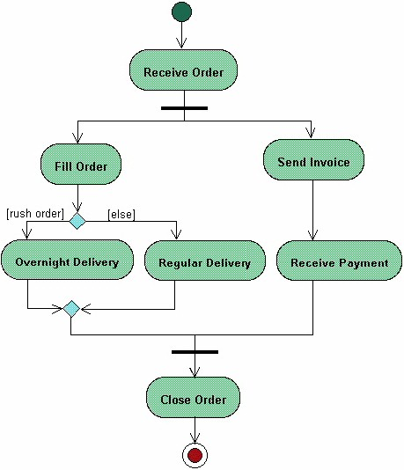
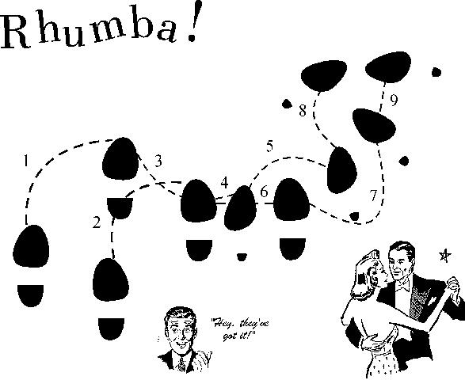
Modeling Tools - Activities Diagram
Start
Activity diagrams describe the workflow behaviour of a system including a sequence of activities performed from start to finish
Fork
Activities could be performed:
- sequential order
- parallel
- conditional transition
Branch
Merge
Joint
End
Notes:
Activity diagrams describe the workflow behavior of a system. The diagrams describe the state of activities by showing the sequence of activities performed. Activity diagrams can show activities that are conditional or parallel.
Activity diagrams should be used in conjunction with other modeling techniques such as interaction diagrams and state diagrams. The main reason to use activity diagrams is to model the workflow behind the system being designed. Activity Diagrams are also useful for: analyzing a use case by describing what actions need to take place and when they should occur; describing a complicated sequential algorithm; and modeling applications with parallel processes.
However, activity diagrams should not take the place of interaction diagrams and state diagrams. Activity diagrams do not give detail about how objects behave or how objects collaborate.
Initial Node (Start): An initial or start node is depicted by a large black spot, as shown below.
Action represents a single step within an activity. Actions are denoted by round-cornered rectangles.
Control Flow (Transition): A control flow shows the flow of control from one action to the next. Its notation is a line with an arrowhead
Decision (branch) and merge nodes have the same notation: a diamond shape. They can both be named. The control flows coming away from a decision node will have guard conditions which will allow control to flow if the guard condition is met.
Forks and joins have the same notation: either a horizontal or vertical bar (the orientation is dependent on whether the control flow is running left to right or top to bottom). They indicate the start and end of concurrent threads of control. The following diagram shows an example of their use.
Forks and joins have the same notation: either a horizontal or vertical bar (the orientation is dependent on whether the control flow is running left to right or top to bottom). They indicate the start and end of concurrent threads of control.
A join is different from a merge in that the join synchronizes two inflows and produces a single outflow. The outflow from a join cannot execute until all inflows have been received. A merge passes any control flows straight through it. If two or more inflows are received by a merge symbol, the action pointed to by its outflow is executed two or more times
Final Node (End): There are two types of final node: activity and flow final nodes. The activity final node is depicted as a circle with a dot inside (see the slide), The flow final node is depicted as a circle with a cross inside.

Slide 56
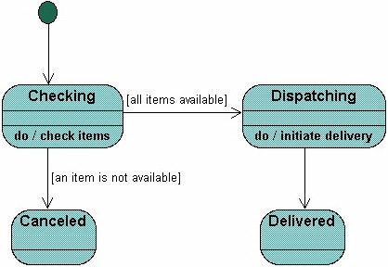
Modeling Tools - State Machine
A State Machine diagram
shows the possible states of
the object and the transitions
that cause a change in state.
?
What is different between activities and Statemachine diagram
Notes:
These model the behaviour of the system in response to external and internal events.
They show the system’s responses to stimuli so are often used for modelling real-time systems.
Show system states as nodes and events as arcs between these nodes. When an event occurs, the system moves from one state to another.
A brief description of the actions is included following the ‘do’ in each state.
Can be complemented by tables describing the states and the stimuli.

Slide 57
Common Practices, Problems
Common issues
Requirement isn't clear. Don't understand customer mean.
Requirement analysis is not documented/centralized recorded -> misunderstanding
How to verify the understanding of team members about requirement
What should we do
Maintain SRS
Communicate with the customer = onsite
Don’t make assumption. Must confirm with customer about specs more and more about what are still not clear or too general.
Should involve all members to investigate requirements from the beginning of the project, not only PL.
Conduct meeting to verify the requirement understanding.
One meeting to introduce the requirement/design.
Another meeting to verified the understanding of team member. Every one have to present their understanding.

Slide 58
Resources & References
Resources & References
Requirement development & management process
Q&A management sheet template
SRS review checklist
RMS template
SRS template

Slide 59
Q & A

